Slide 1
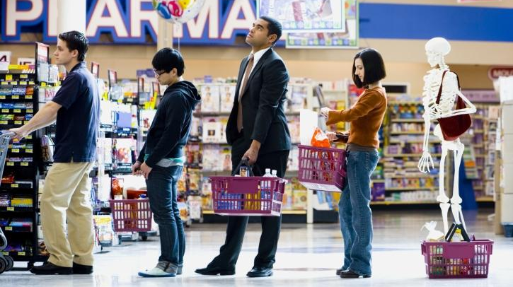

Slide 2
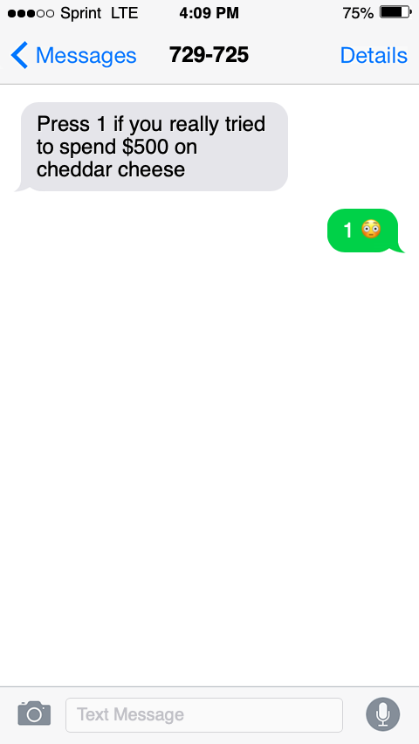

Slide 3

THE $30 BILLION PROBLEM
Capstone Project
Fraud Detection

Slide 4
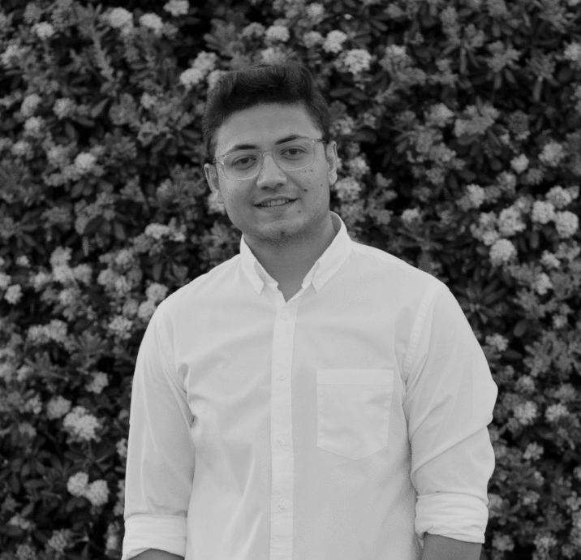
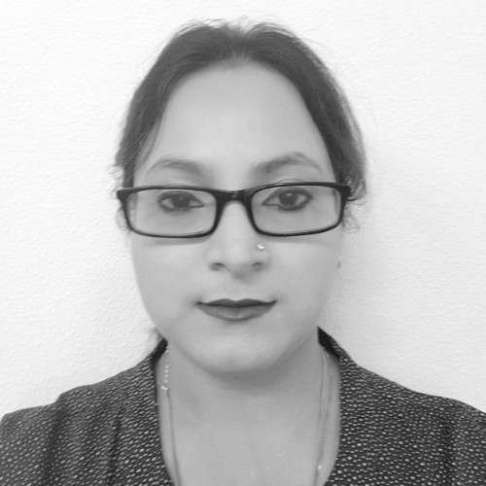
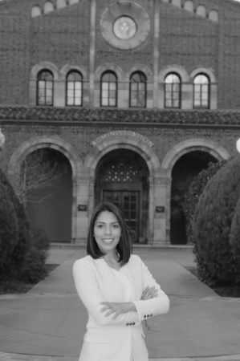
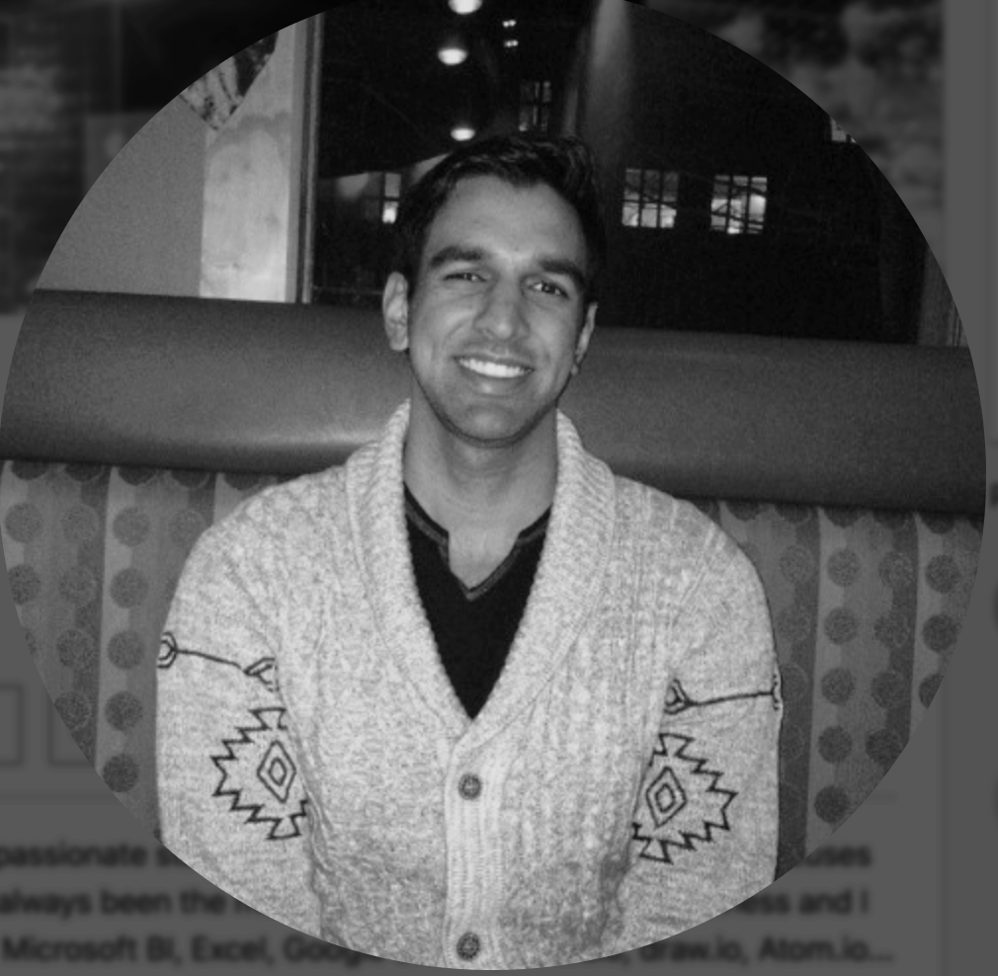
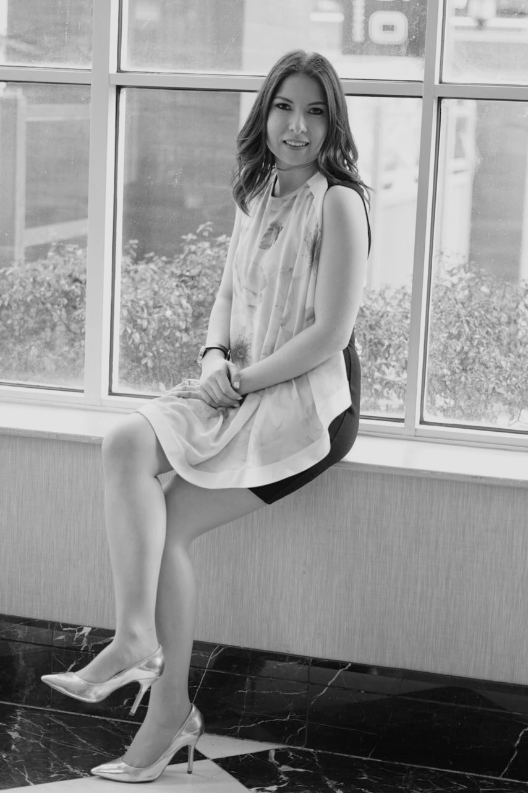
THE TEAM
Syed Jafri
Priyadarshini De
Daniela Gonzalez
AJ Dhillon
Andrea Rodriguez

Slide 5





PROBLEM
GOAL
Improve the efficacy of fraudulent transaction alerts & the customer experience for millions of people around the world.
False Positives
Predict the probability that an online transaction is fraudulent
Help businesses reduce their fraud loss & increase their revenue.
31%
Credit Card is the Most common type of fraud.
Sponsor: IEEE Computational Intelligence Society & Vesta Corporation

Slide 6




THE DATASET
590,540
144,233
rows
Binary classification problem
rows
434
Transaction Train data
Identity Train data
40
Columns
Columns
Categorical features
Transaction
Identity
ProductCD Emaildomain card1 - card6
addr1, addr2 P_emaildomain R_emaildomain
DeviceType DeviceInfo id_12 - id_38
M1 - M9
Joined by : TransactionID
Source: Kaggle (https://www.kaggle.com/c/ieee-fraud-detection)

Slide 7




PROCESS OVERVIEW
PREPROCESSING & CLEANING
-Merge train & test datasets
-Rename columns
-Add ‘is fraud’ column
-Find descriptions of the dataset
MACHINE LEARNING
-Logistic Regression
-SMOTETomek (Over/Undersampling)
-PCA
-XGBOOST
-LightGBM
-Decision Tree
-LightGBM
-Random Forest
-Deep Neural Network
04
Programming Language Used: Python
01
03
DATA EXPLORATION
-Distribution of Transaction Amount
-Descriptive Visualizations
02
DATA PREPARATION
-Preprocessing encoder.
-Feature engineering.
-Memory Reduction.

Slide 8

DATA EXPLORATION

Slide 9
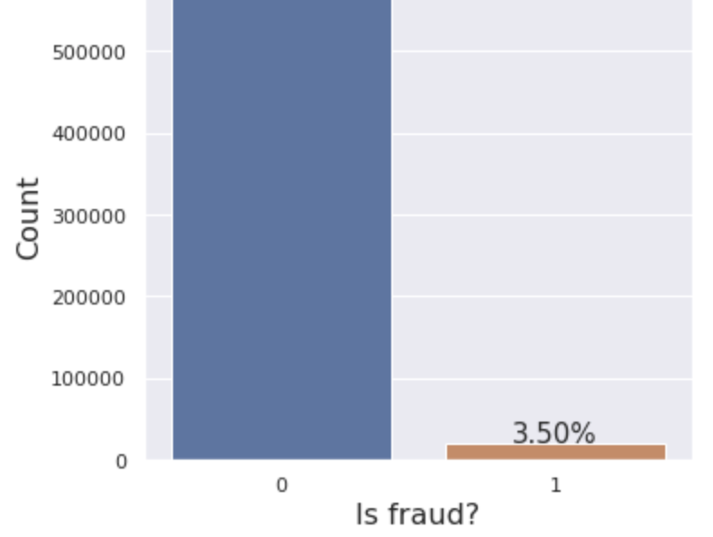
TARGET DISTRIBUTION
NO FRAUD
96.50%
Observations:
Imbalance Data : unequal distribution of fraudulent and not fraud transactions
Problem: The metric trap, resulting in an illusory high accuracy rate.
IS FRAUD
3.50%
Notes:
if the classifier always "predicts" the most common class without performing any analysis of the features, it will still have a high accuracy rate, obviously illusory.
-Daniela
20.633K frauds
569.877k Non Frauds

Slide 10
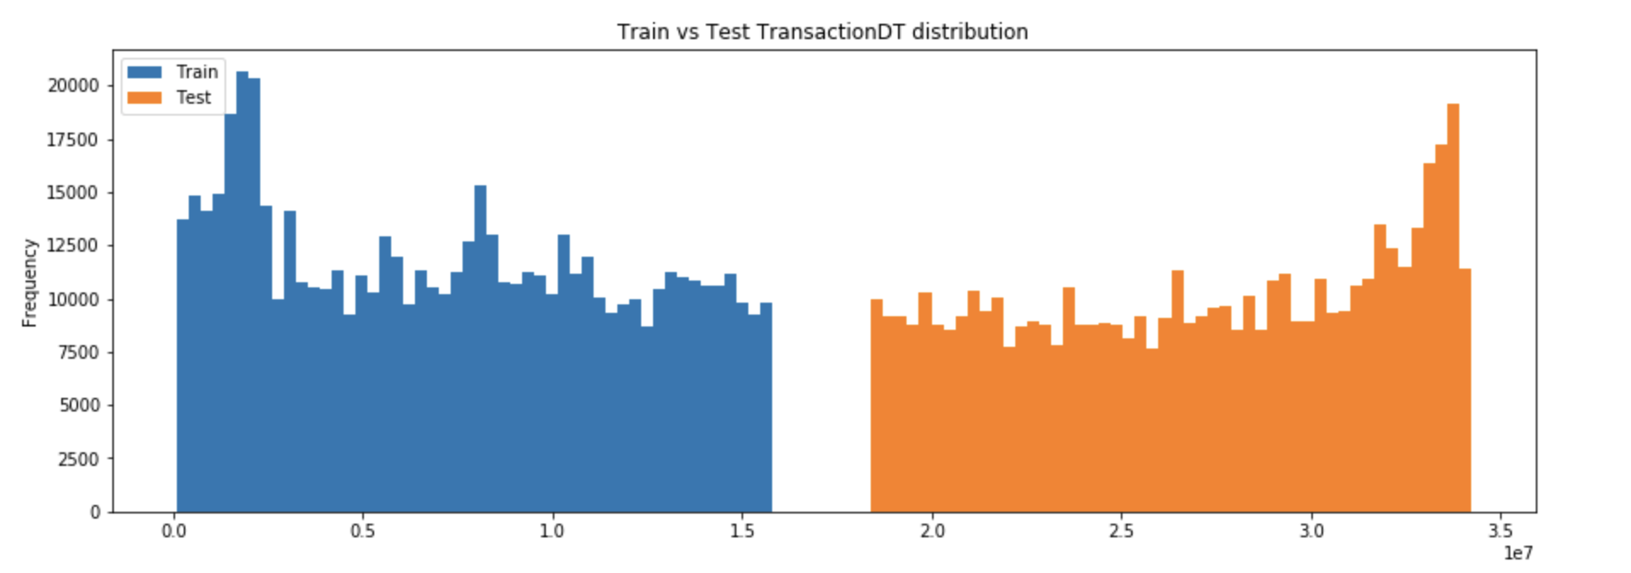
DISTRIBUTION OF TRANSACTION DATES
Observations:
TransactionDT is a timedelta
Train and test transaction dates don't overlap.
Training set is from an earlier period of time and test is from a later period of time
Notes:
The transaction are for 1 year (365 days)
But there month gap in the dataset

Slide 11
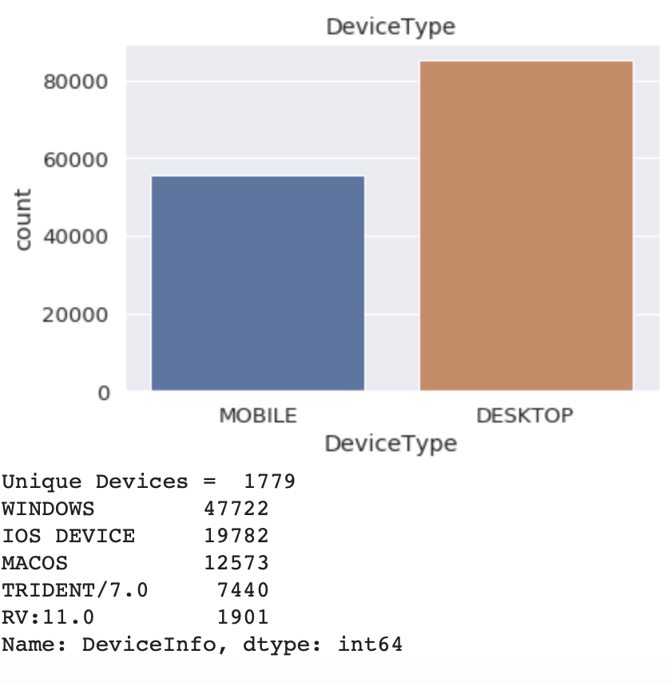





Total Transactions per Operating System
47,722
19,782
Windows
IOS
12,573
9,341
Mac OS
Others
Unique Devices:
1,779
DEVICE TYPE & INFO
Notes:
Daniela
Over 80,000 are desktop.. L
A little less than 60,000 are mobile
All transactions in the dataset were made on 1779 unique devices,
OS info

Slide 12
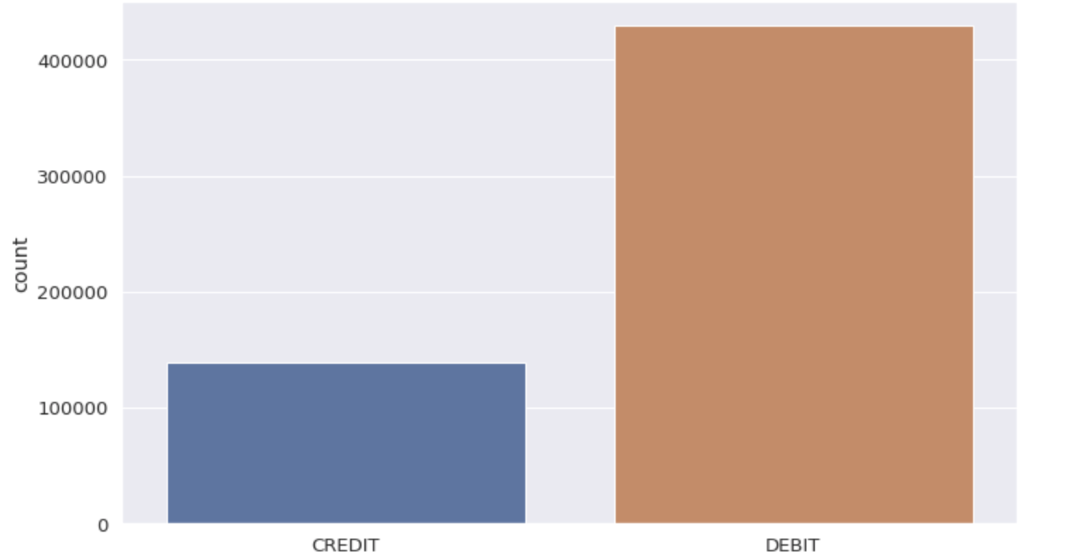
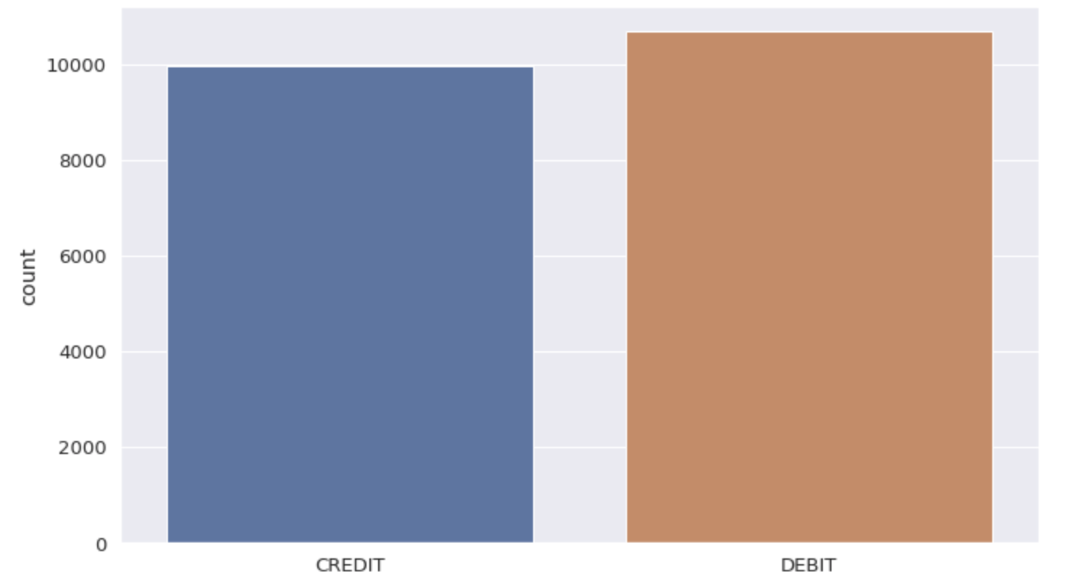
CREDIT CARDS VS DEBIT CARDS
NO FRAUD
IS FRAUD
High percentage of Frauds in Credit than Debit transactions.
Notes:
Daniela
Higher % on cc versus debit card, per volume

Slide 13
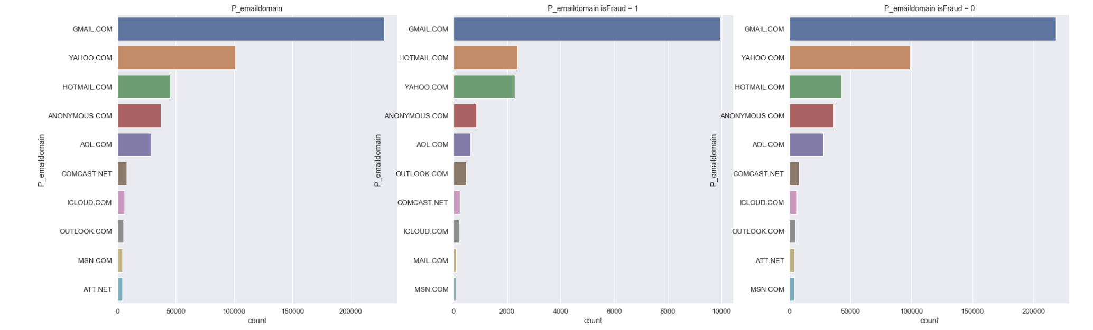
TOTAL EMAIL DOMAINS
IS FRAUD
NO FRAUD
EMAIL DOMAIN
Notes:
First graph shows total email domains in our dataset
Second one shows fraud in gmail but its just the data exploration so we can conclude that gmail is prune to fraudulent transactions

Slide 14
DATA PREPARATION
Notes:
Introduction (Andrea)
Visualization (Daniela)
-Feature Engineer, Encoder, Imputation and Memory Reduction (Syed)
-SMOTE (Over/Undersampling) (Priya)
-PCA (Priya) (Standard Scaler)
-Logistic Regression (Ajay)
-XGBOOST(Ajay)
-LightGBM (Syed)
- Things we tried: Random Forest, K-means, Deep Neural Networks and RNN (Syed)

Slide 15




...GETTING FROM DATA TO MODELING
Input Data
Data Preparation
Insights
Data Processing
Feature Engineering
Features
Modeling
Numerical and Object Type
Improve Performance of Models.
Preprocessing Encoder: converted 31 columns( LabelEncoder & LabelBinarizer)
Aggregations on V features.
39 New features: e.g TransactionDT Weekdays, TransactionDT Hours, etc.
Memory Reduction: Decreased by 71.8%.
Notes:
Syed
One of most important part of the project was data processing and feature engineering
We have two types of data (numerical and Object type
So we have to convert the data type and encode it using labelencoder and labelbinarizer
We also created a memory reduction function which converted float64 data to float16
We did feature engineering, we added few v features together containing NANs
We had a time Transaction date time feature but it was hard to use since it was delta time
We split that feature into weekdays, hours
We also took log of transaction amt feature
Priya will go into more details

Slide 16
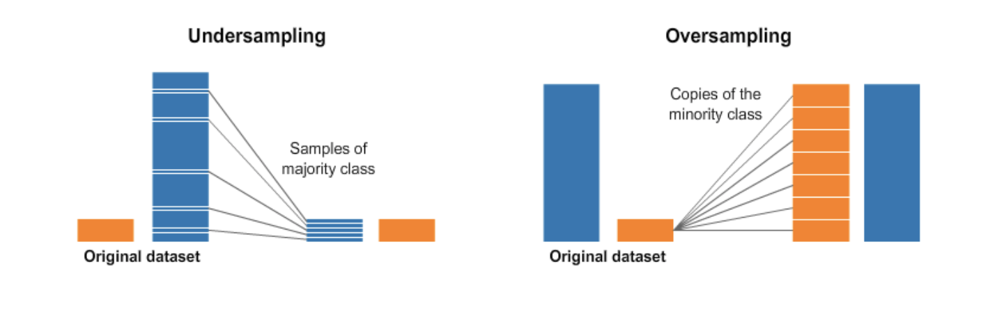
SMOTETomek
Remove samples from the No Fraud class (undersampling) and adding more samples from the Fraud class (oversampling)..
Notes:
Increase the number of cases in the dataset in a balanced way.
A widely adopted technique for dealing with highly unbalanced datasets is called resampling. It consists of removing samples from the majority class (under-sampling) and / or adding more examples from the minority class (over-sampling).

Slide 17
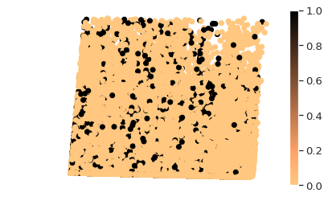
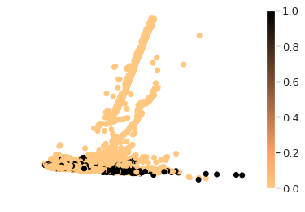
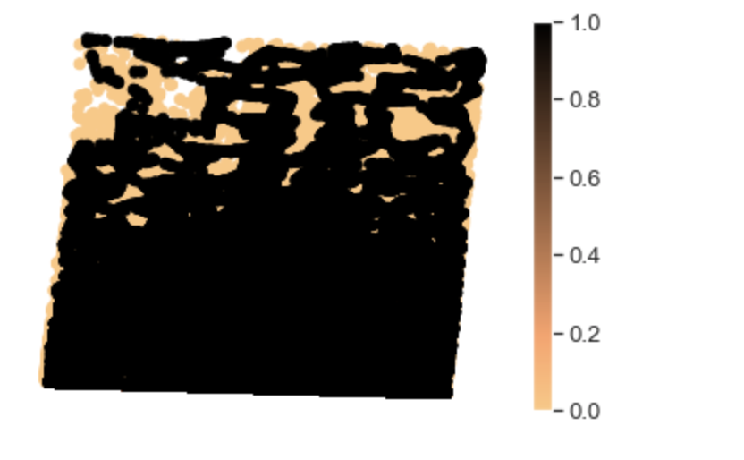
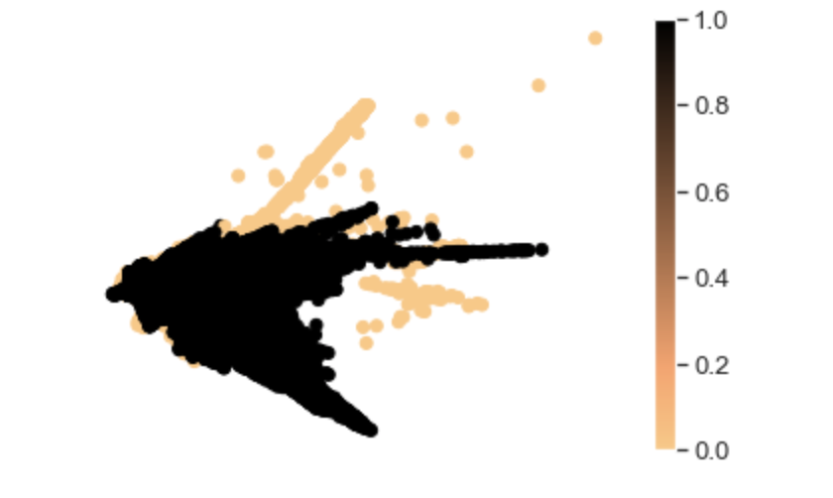
PCA
NOT SCALED
SCALED
Reduce dimensionality of the data.
BEFORE SMOTE
AFTER SMOTE

Slide 18
MACHINE LEARNING
Notes:
Introduction (Andrea)
Visualization (Daniela)
-Feature Engineer, Encoder, Imputation and Memory Reduction (Syed)
-SMOTE (Over/Undersampling) (Priya)
-PCA (Priya) (Standard Scaler)
-Logistic Regression (Ajay)
-XGBOOST(Ajay)
-LightGBM (Syed)
- Things we tried: Random Forest, K-means, Deep Neural Networks and RNN

Slide 19
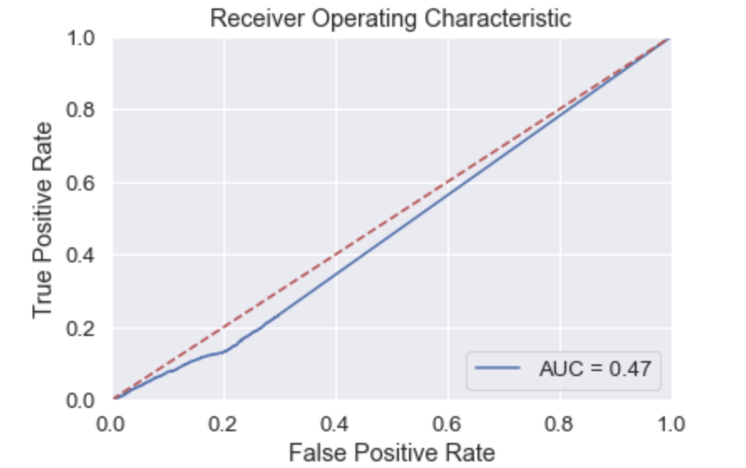
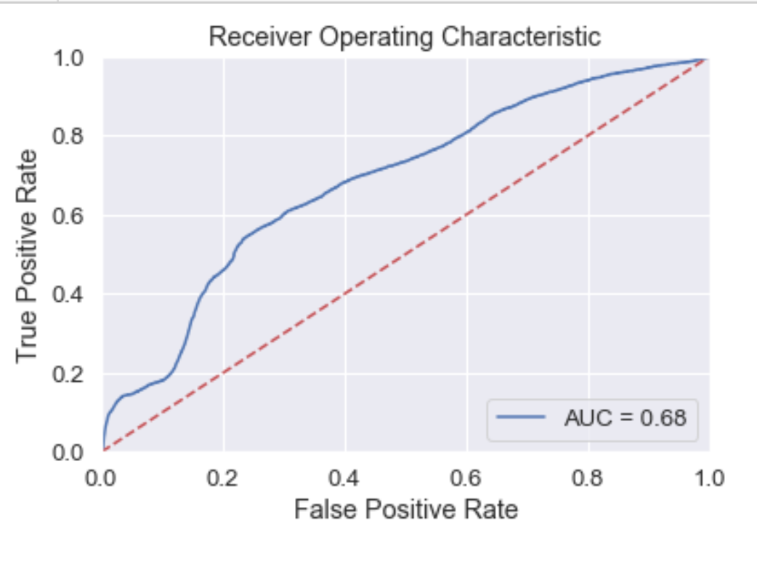
LOGISTIC REGRESSION
WITHOUT PCA
95%
Test Accuracy:
AUC: 0.47
WITH PCA
96%
Test Accuracy:
AUC: 0.68
Notes:
Without PCA
Acc 95%
AUC 0.47
With PCA
Acc 96%
AUC 0.68

Slide 20
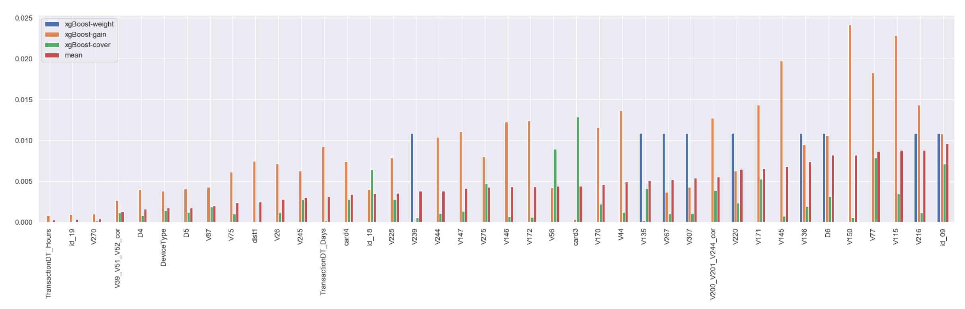

XGBOOST
MEAN AUC:
0.88
Notes:
MEAN AUC 0.98
The Gain implies the relative contribution of the corresponding feature
Coverage metric means the relative number of observations related to this feature
The Frequency (R)/Weight (python) is the percentage representing the relative number of times a particular feature occurs in the trees of the model.

Slide 21
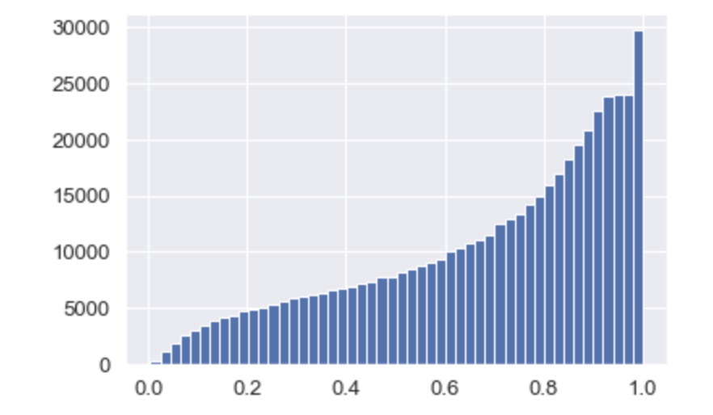

LightGBM
IS Fraud Prediction
Predicted 18,518 frauds
Test AUC 0.93
Model tuning
Number of rounds : 200, 800, 10,000, 40,000, 100,000
Performance:
Notes:
Syed
This is our star model that gave us the best results
LightGBM can use categorical features directly (without one-hot encoding). 8x speed-up compared with one-hot encoding.
LightGBM also supports weighted training, we added weight on is fraud
We used early stopping to find the optimal number of boosting rounds

Slide 22

OTHER APPROACHES
Random Forest
Deep Neural Networks
Decision tree
RNN
Notes:
Syed

Slide 23
Our process in the competition...
Total Submissions:
16
1
4
6
16
Score 0.8587
Score 0.9222
Score 0.9305
Score 0.9352
Leaderboard Number 1
0.9666
.
Submissions are evaluated on area under the ROC curve between the predicted probability and the observed target.
...We’ll keep doing submissions until October 1st.
Notes:
Syed
Submissions are evaluated on area under the ROC curve between the predicted probability and the observed target.

Slide 24
THANK YOU !
QUESTIONS?

